Slide 1


Sequence Quality Assessment

Slide 2
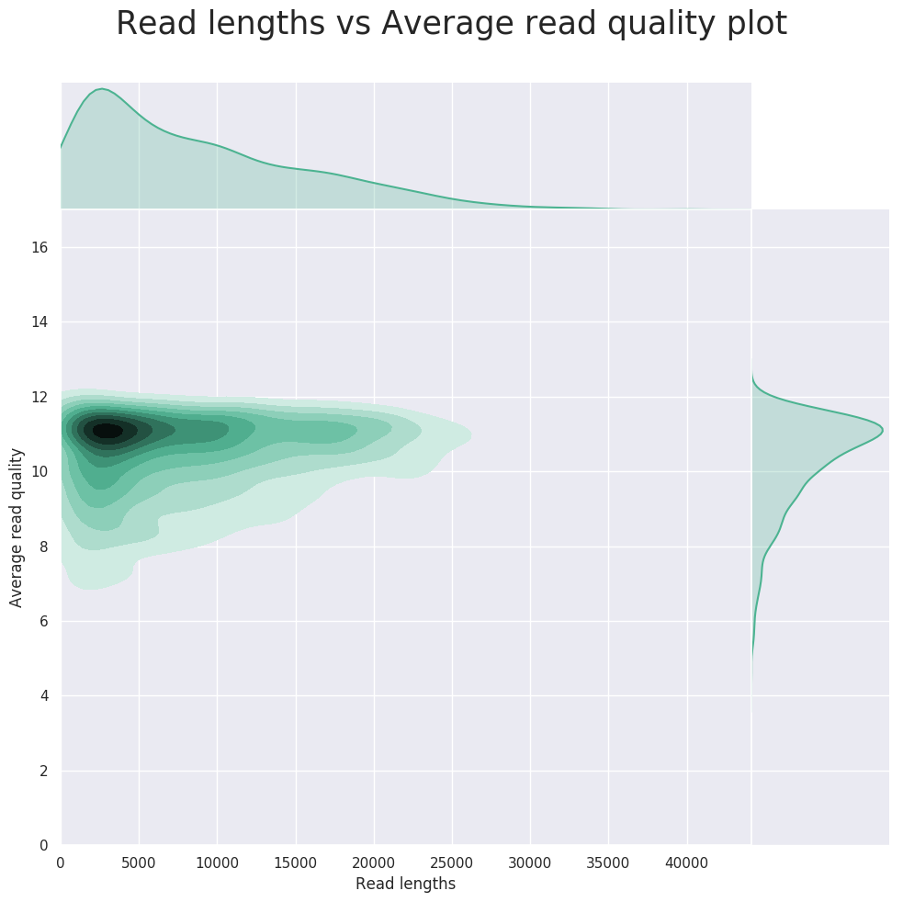
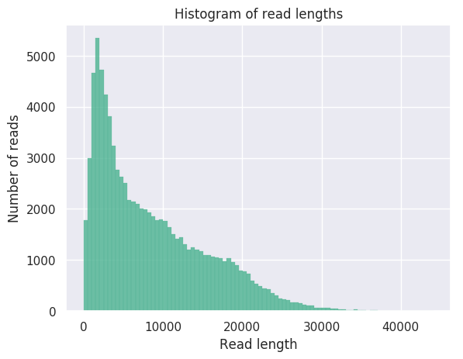
NanoPlot - Summarizing data
Designed for Iong read data.
What does it tell you?
Total data
Sequence length distribution
Sequence quality distribution

Slide 3
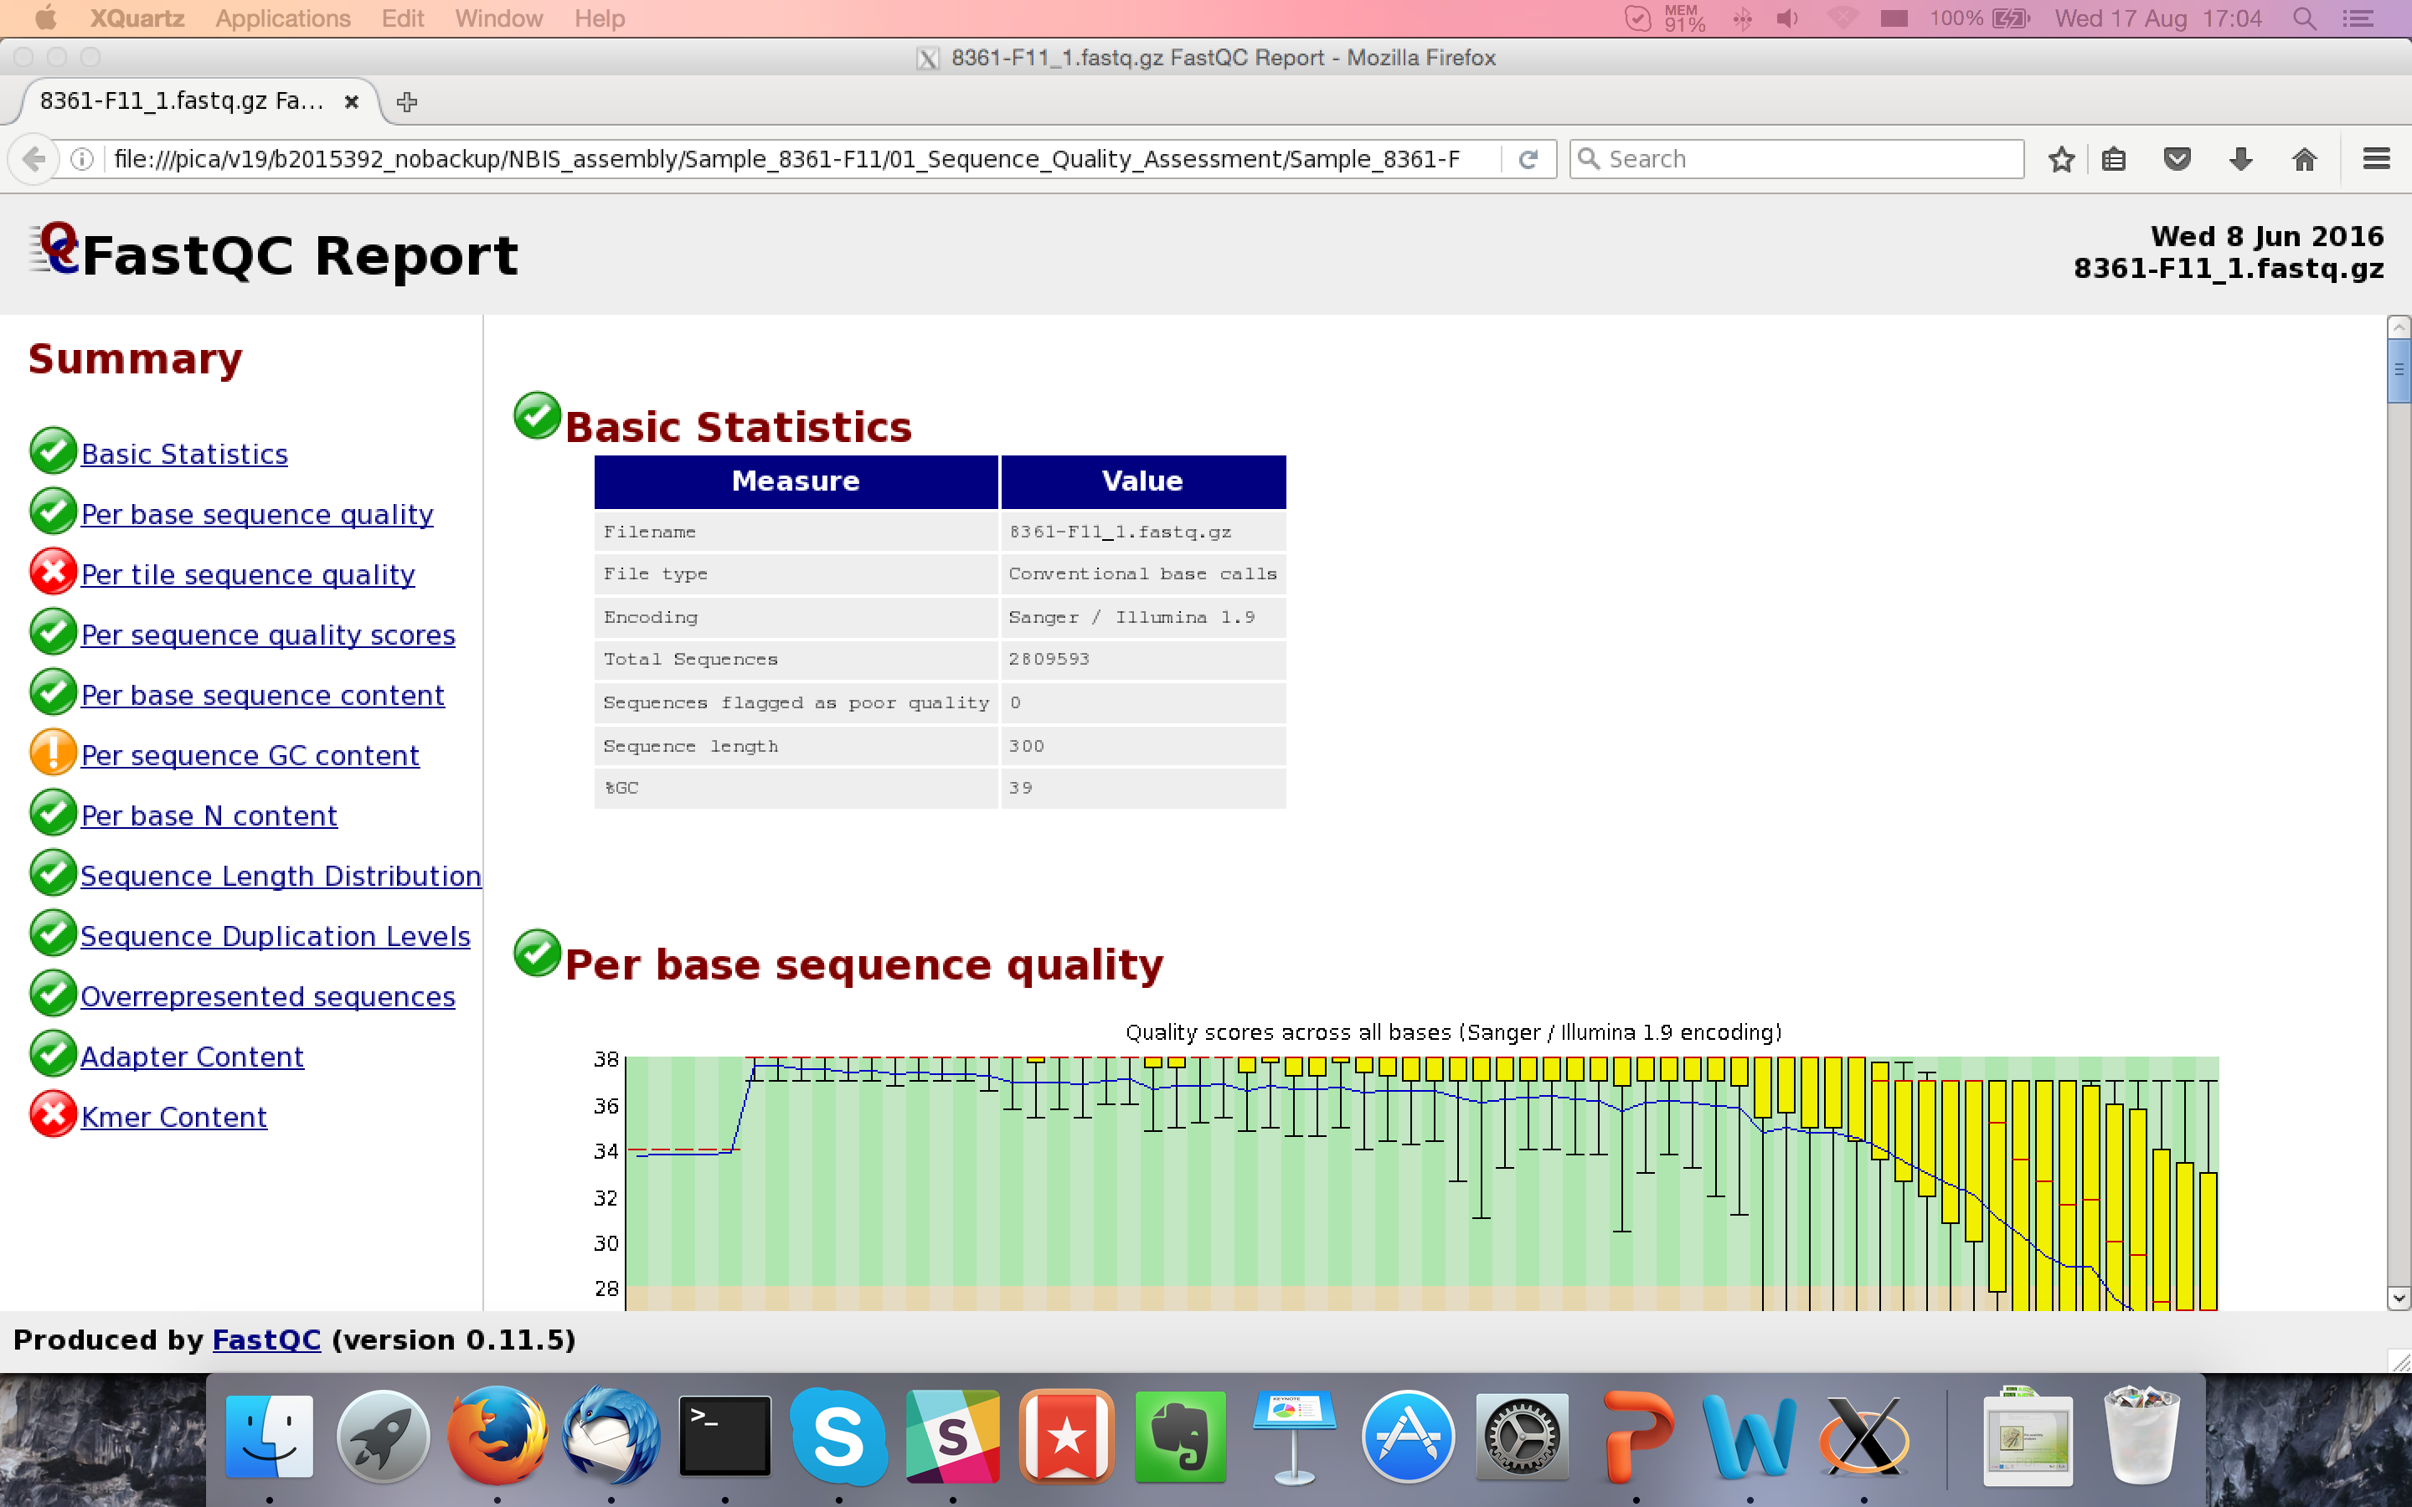
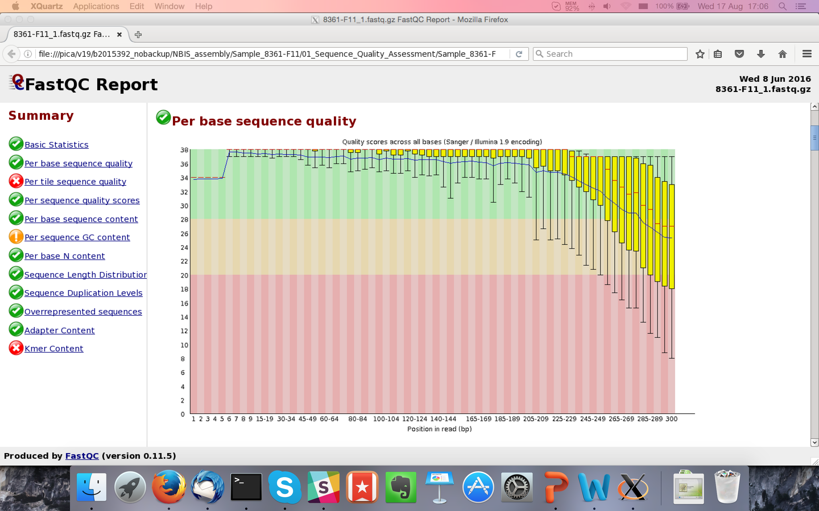
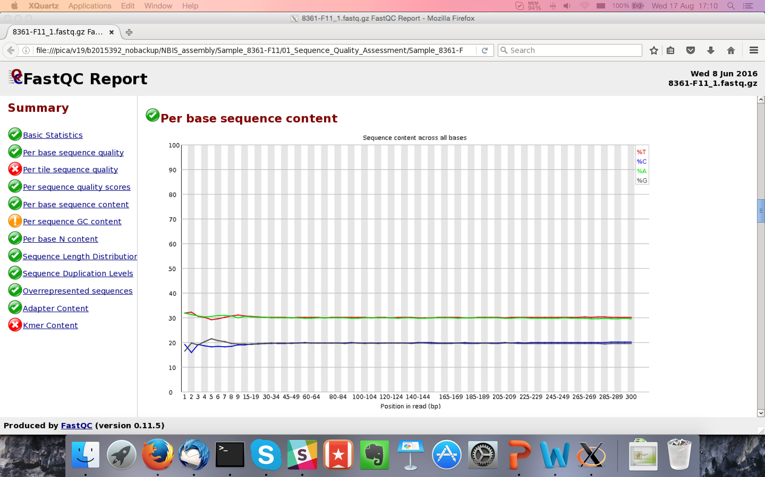
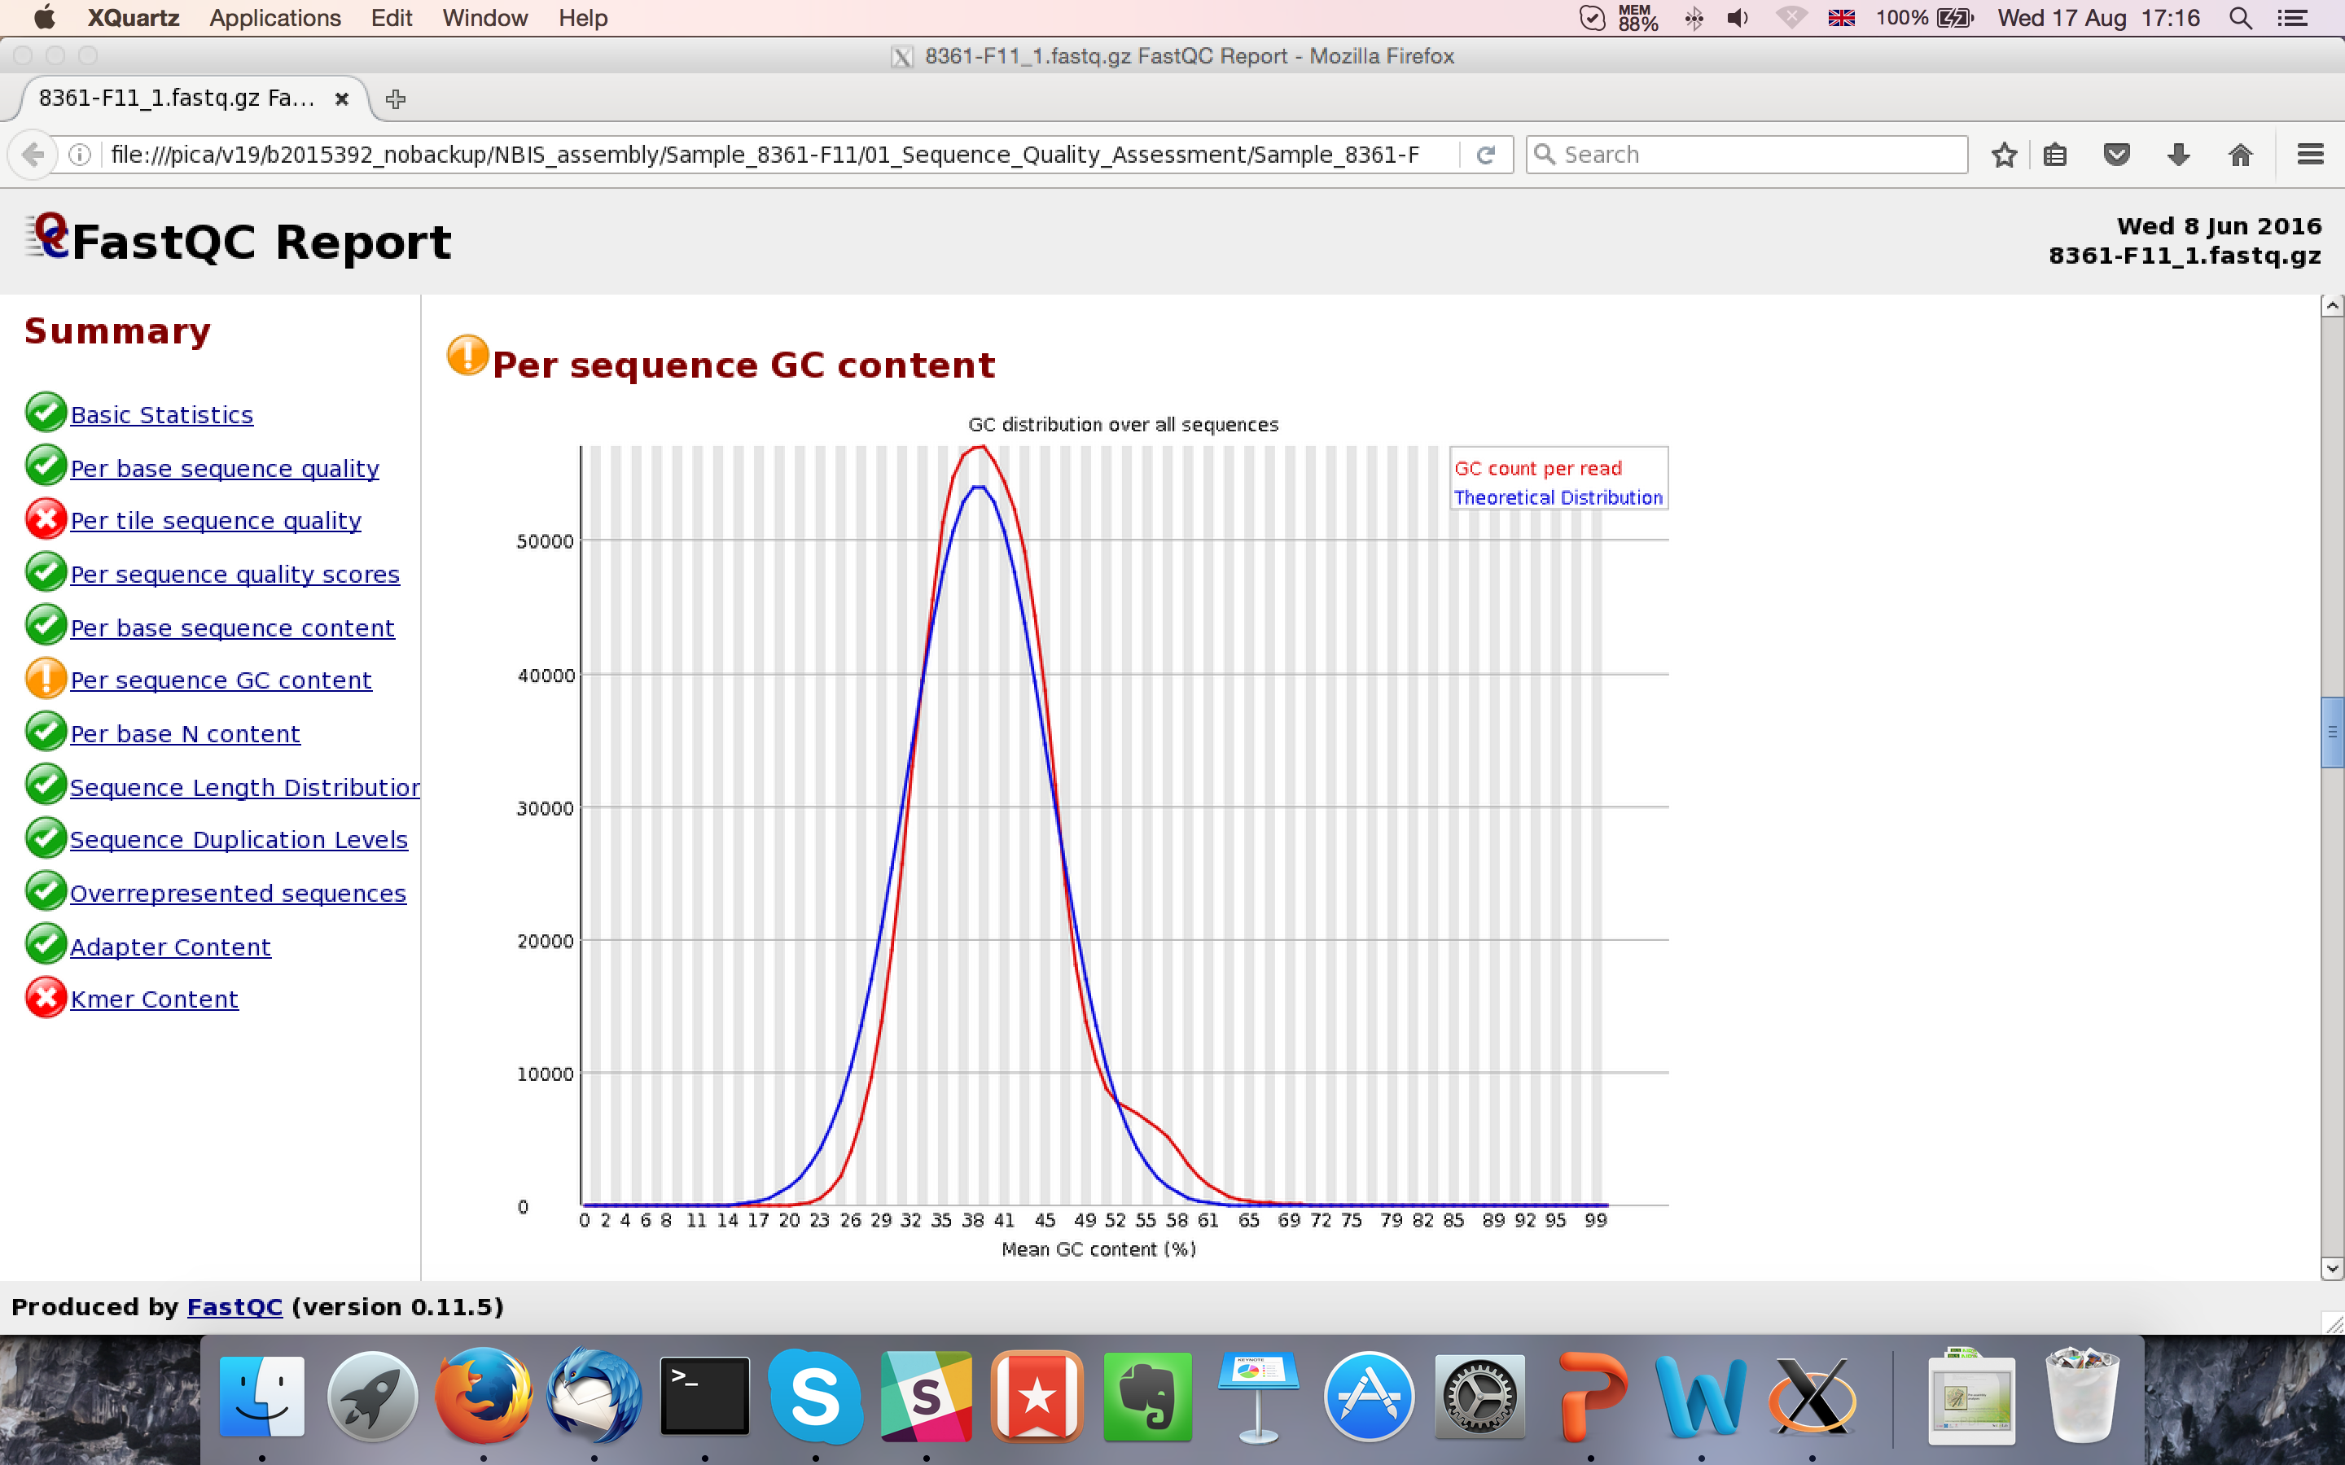
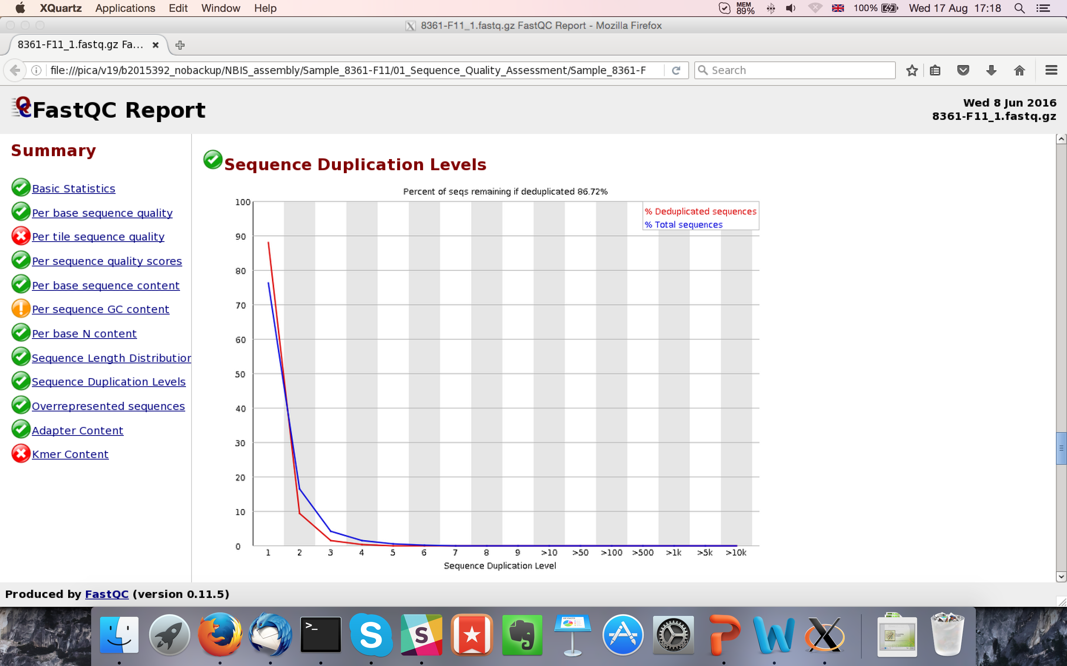
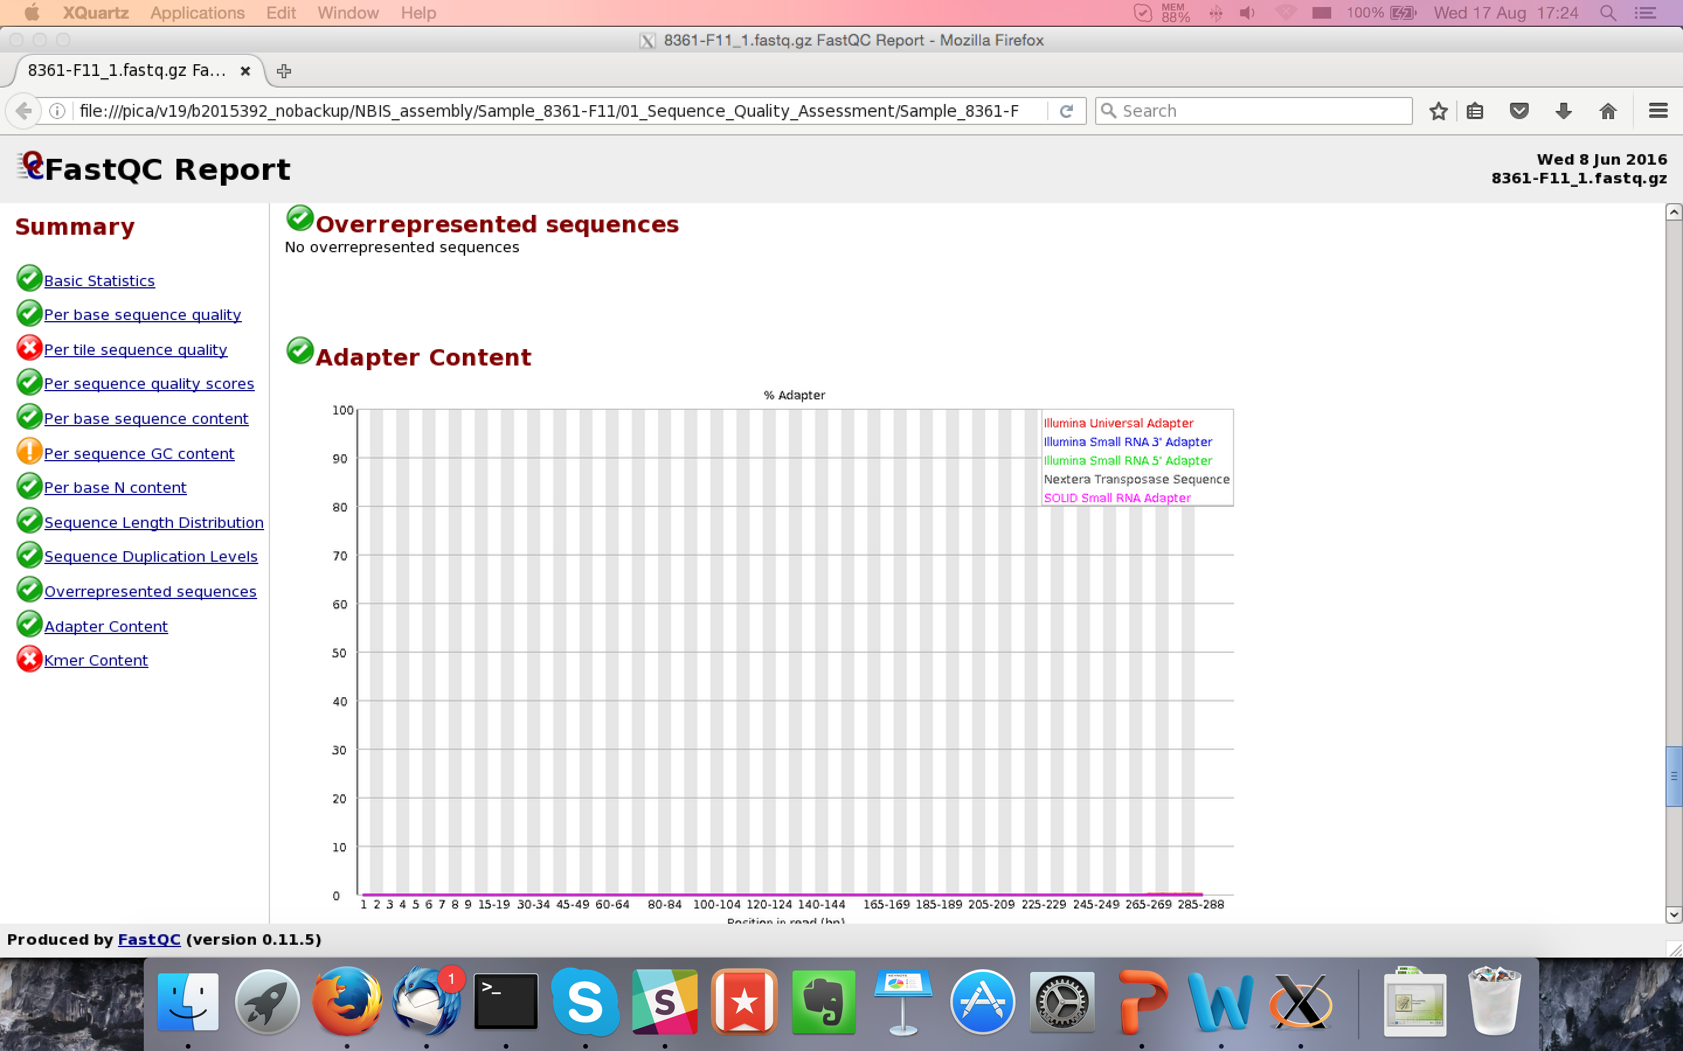
FastQC - Summarizing data
Designed for Illumina data.
What does it tell you?
Total read pairs
Sequence length
Quality Score Encoding
Average GC%
Base quality along the read
Nucleotide % along the read
Sequence GC content
Duplication %
Adapter content
Look at MultiQC for multiple samples

Slide 4
FastQC

Slide 5
FastQC

Slide 6
FastQC
Q(40) => Error probability = 0.0001
Blue line = mean quality
Good Quality
Q(30) => Error probability = 0.001
Reasonable Quality
Phred Quality Score
Q(20) => Error probability = 0.01
Normal: Quality tends to degrade
near end of read.
1st read pair file often has slightly
better scores than 2nd read pair file.
Poor Quality
Illumina data

Slide 7
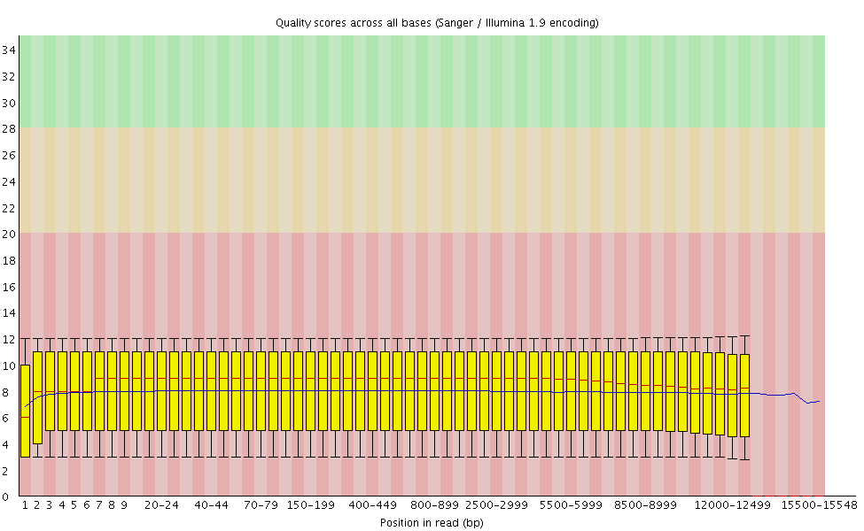
FastQC
PacBio data

Slide 8
FastQC

Slide 9
FastQC
Expected Result: First few bases are not quite uniform.
Caused by Illumina primers. Results in minor fragment
selection bias.
Note: Trimming bases hides the bias. It does not fix it.
Expected: Uniform distribution at half of AT%
Expected: Uniform distribution at half of GC%

Slide 10
FastQC

Slide 11
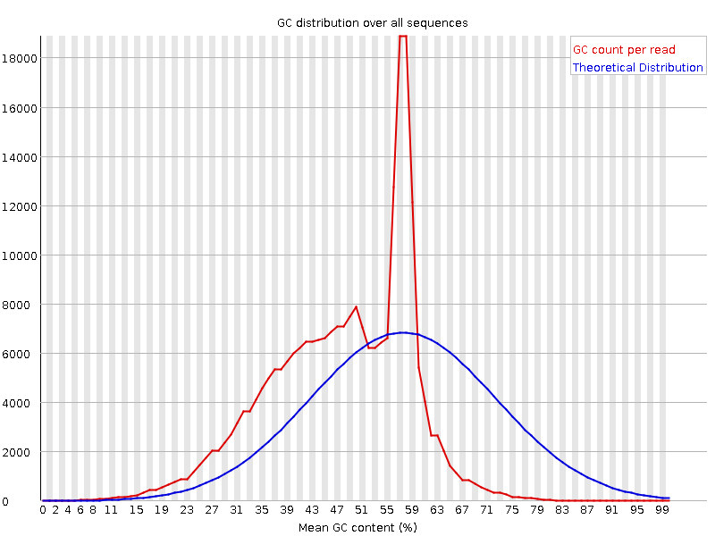
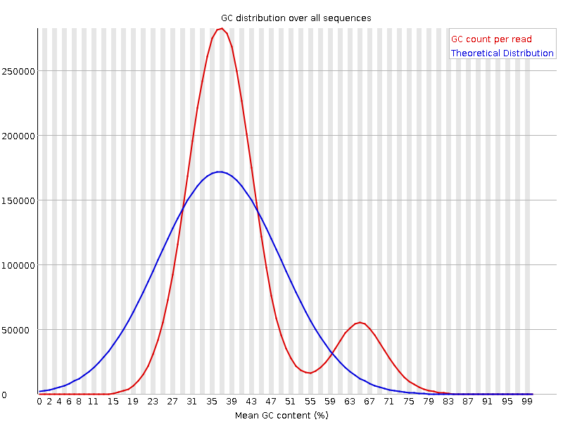
FastQC
This might be contamination or a feature of the genome
Sharp peak indicates
specific motif. Adapters are the usual suspect.
Wider or multiple distributions suggest contamination.
Expected: Normal/Gaussian Distribution

Slide 12
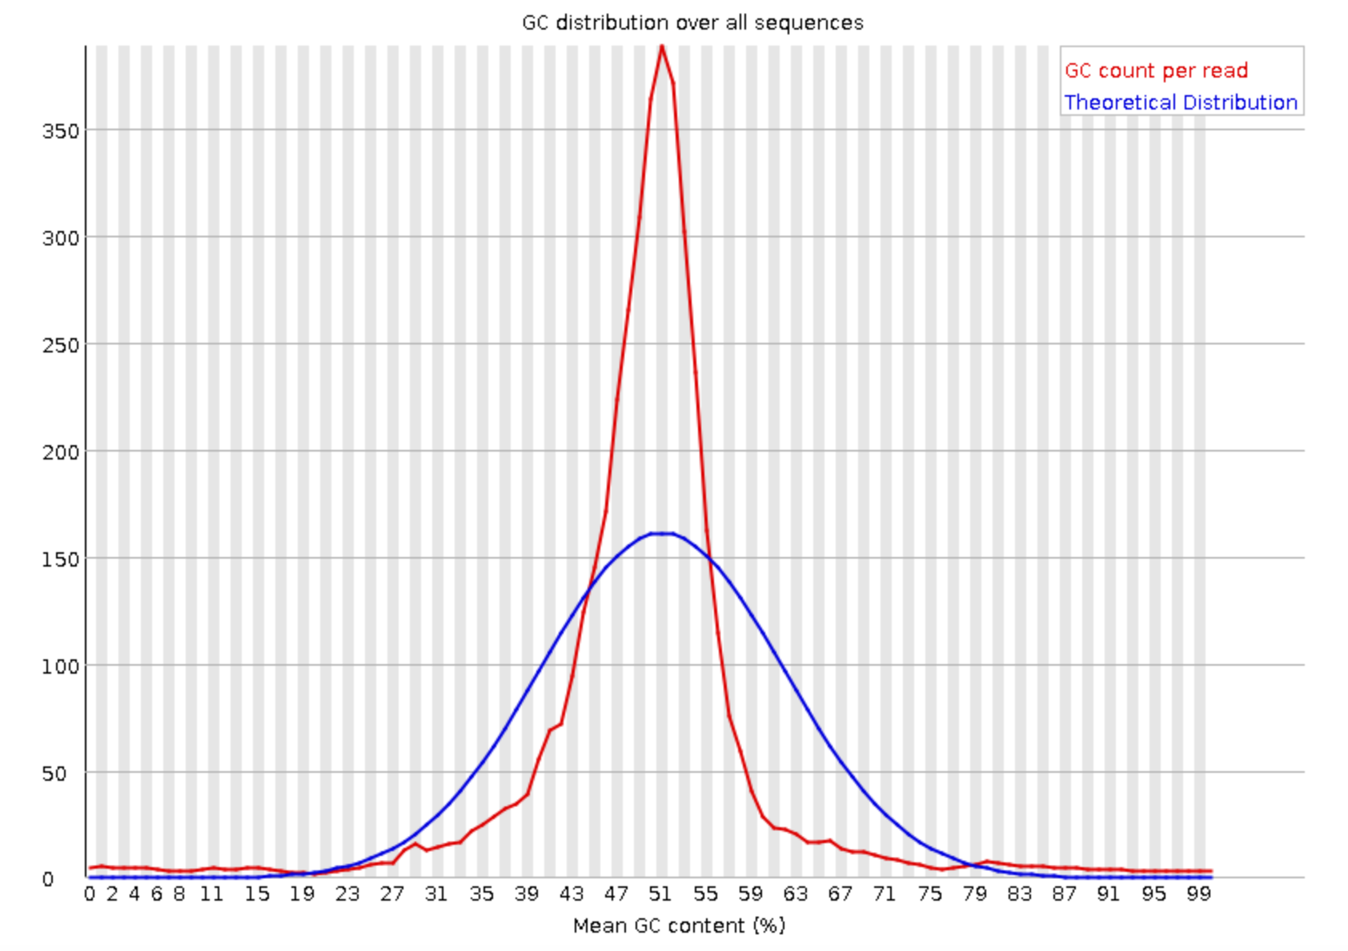
FastQC
PacBio data

Slide 13
FastQC

Slide 14
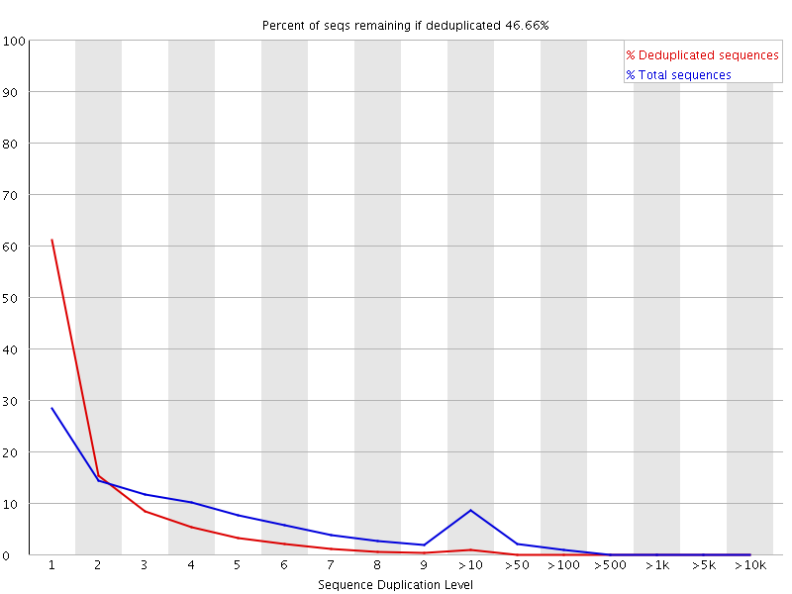
FastQC
First 100,000 sequences tracked until end of file
Exact sequence match
How much data is left after deduplication.
Sequences over 75bp are truncated to 50bp
Percentage of sequences with duplication y
Red trace should show sequences in library are diverse. Many low frequency sequences.
If peak persists in the red trace then there might be severe technical duplication or contamination
Peak shows 10%+ sequences with high duplication levels

Slide 15
FastQC

Slide 16
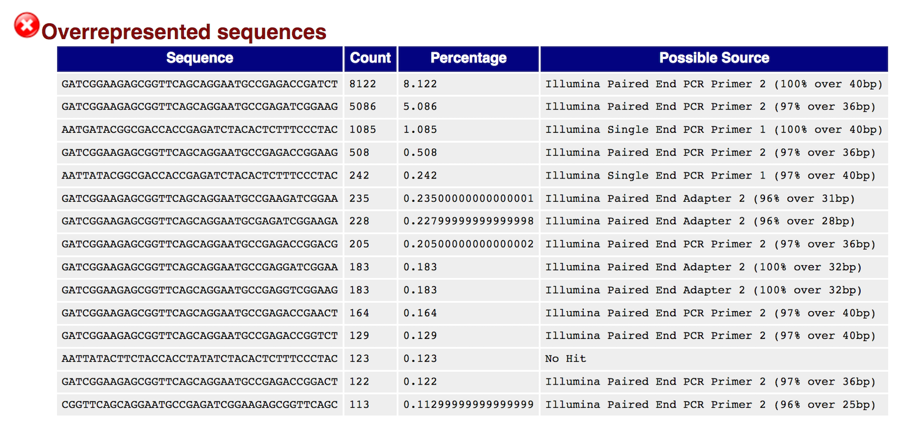
FastQC
First 100,000 sequences tracked until end of file
Lists sequence that is more than 0.1%
Overrepresented sequences are matched against known contaminants.
Match hits are not conclusive, but indicative.
Matches must be >20bp and only 1 mismatch.
Adapter content specifically checks k-mers for matches to known adapter sequence.

Slide 17
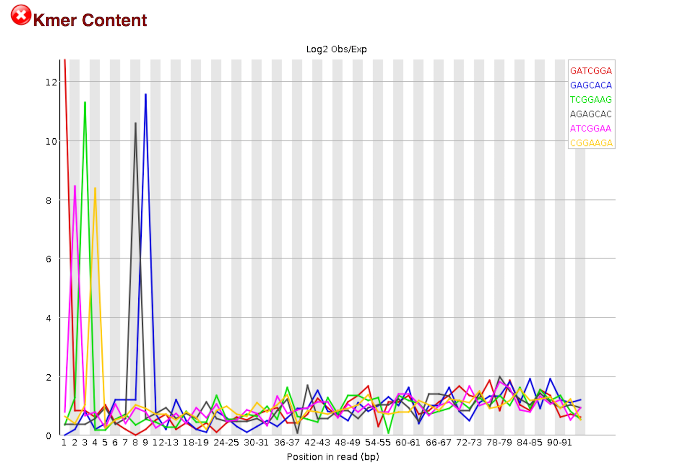
FastQC

Slide 18
FastQC
Is a k-mer over-represented along the length of a read? All k-mers should have equal probability of occurring at any position in the read.
K-mers are consistent with Illumina TruSeq adapter sequence.
Over-representation at the beginning of the read implies many adapters with no DNA fragment in between.
Default k is 7. K-mer size can be increased with option -k

Slide 19
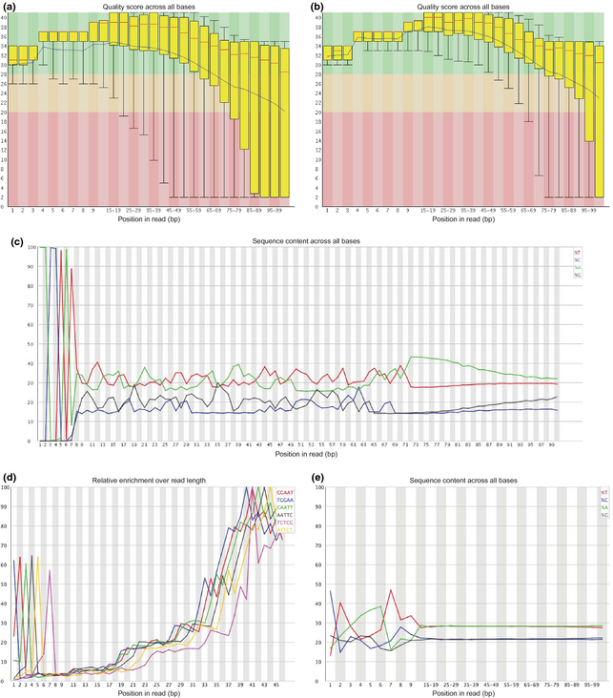
FastQC
Heavy adapter contamination consistent with short DNA fragments between adapters
K-mers consistent with adapter sequences and barcodes/indices

Slide 20
Contamination
Many sources of contamination
Unexpected organisms
Bad reagents
Lab contamination
Sample cross over
…
Artificial constructs
Adapters
Vectors
Spike-in
Detection depends on your database.
Many software:
Fastq Screen
Kraken
Kaiju
Blast
DeconSeq

Slide 21
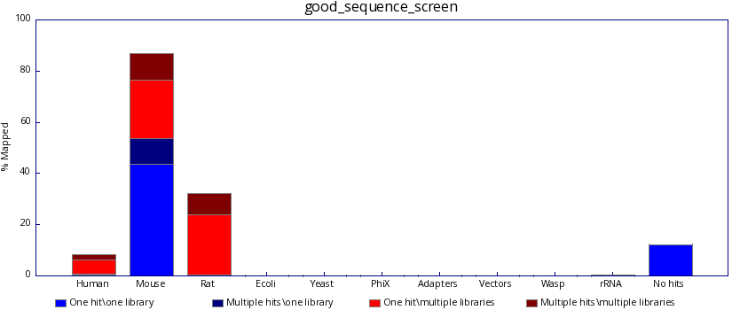
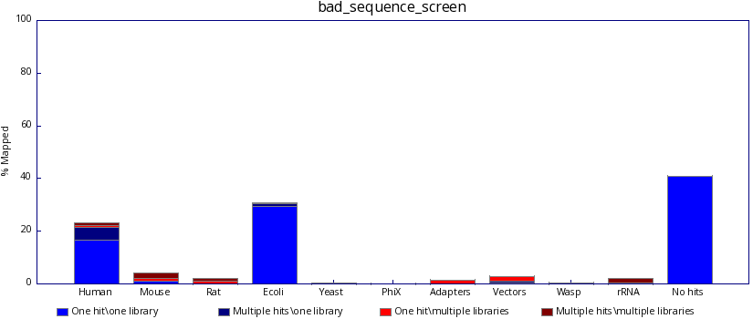
Contamination - FastQ Screen

Slide 22
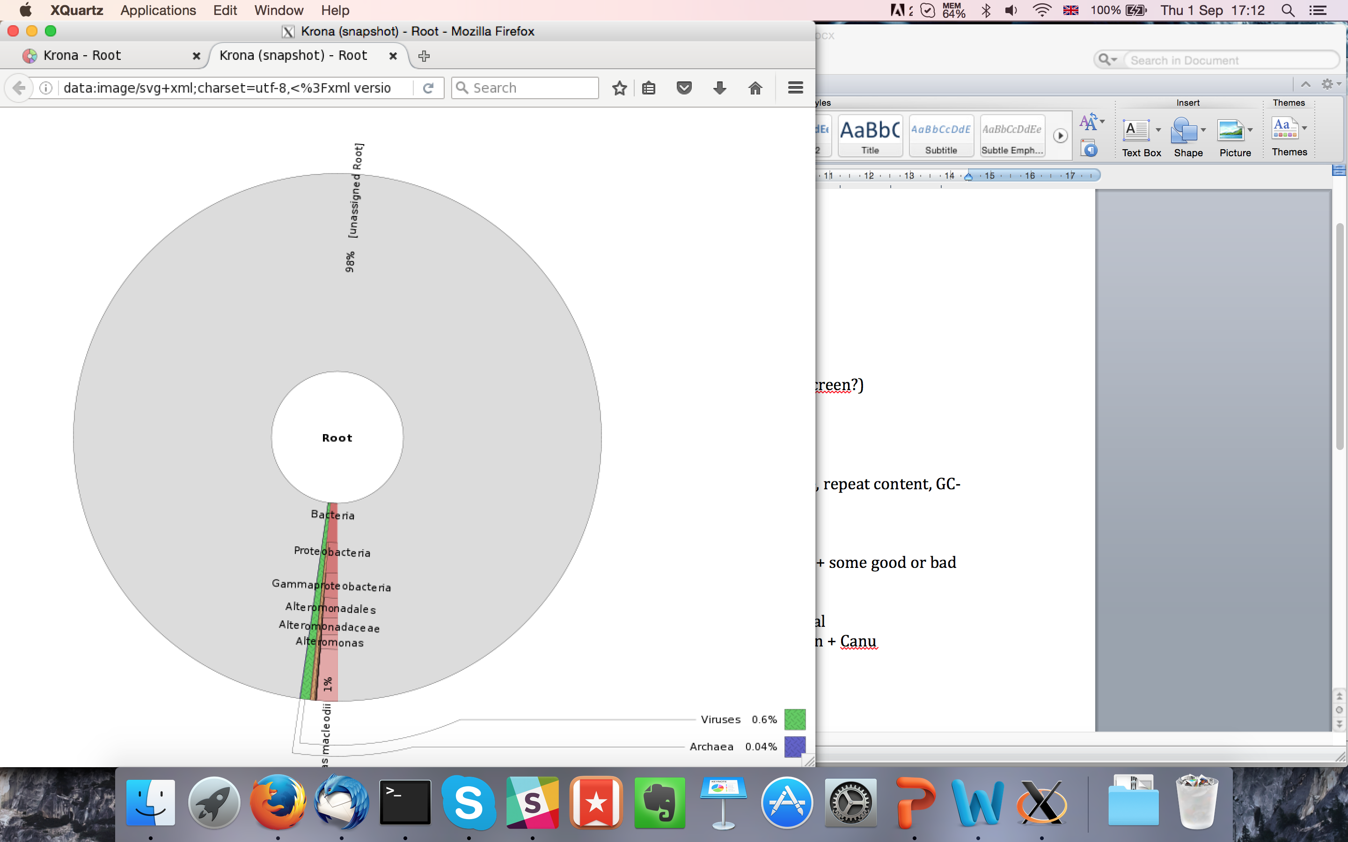
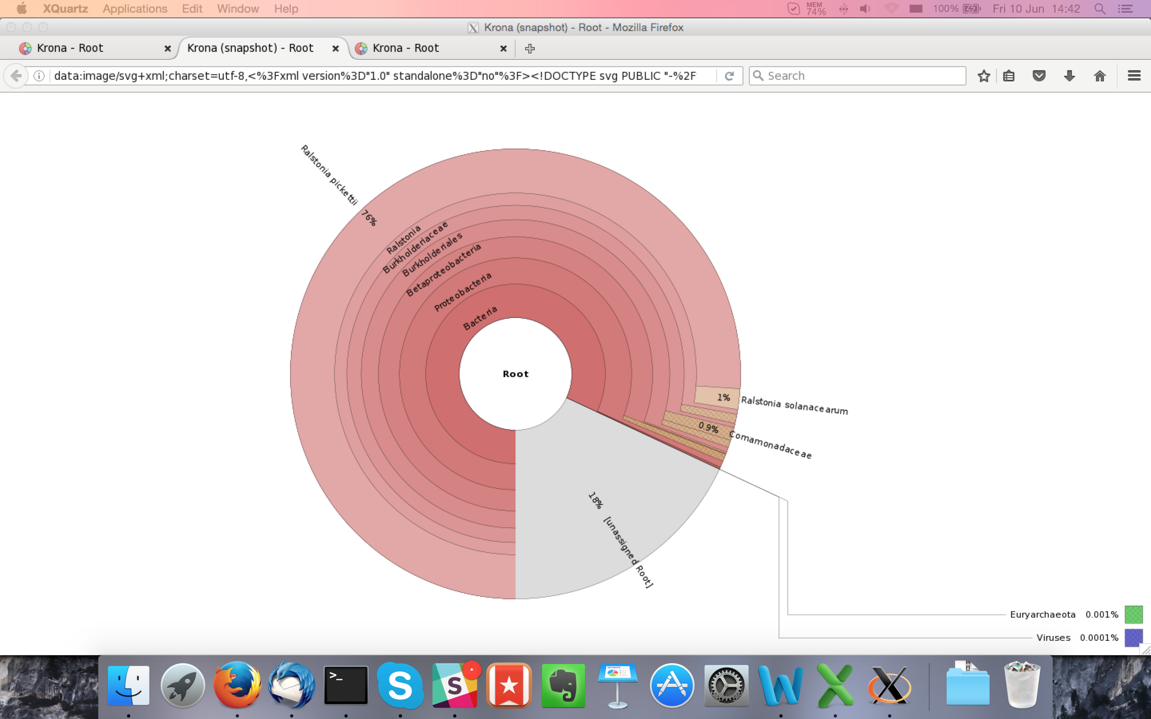
Contamination Analyses
Generalized search with Blast or Kaiju against nt/nr database
Archea, Bacteria, and Virus search with Kraken.
Kraken, Kaiju, and Blast searches can be visualized with Krona.

Slide 23
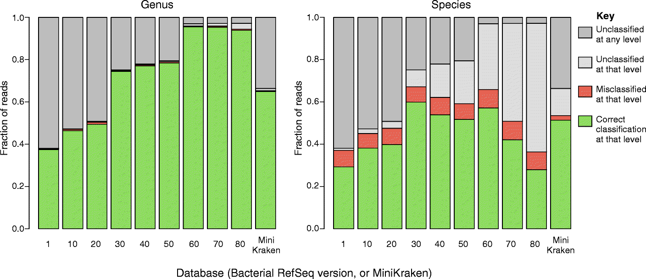
Contamination Analyses
Read based contamination analyses are tricky
Entirely dependent on your reference database
Published contaminated sequence increases false positives
Short k-mer matching increases alignment to multiple targets
Unrelated organisms can contain similar strings of nucleotides
Nasko et al. 2018

Slide 24
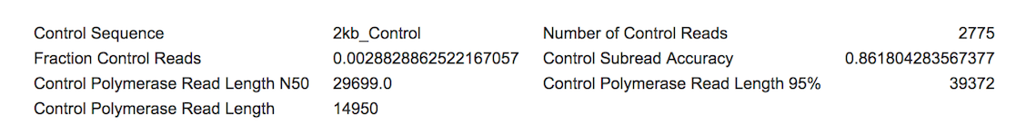
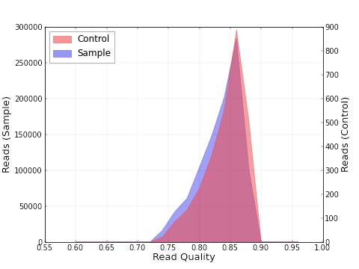
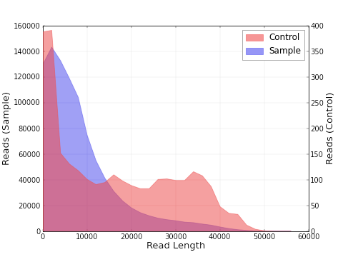
Spike-in sequence - Control reads
Spike-ins are useful for QC but are often not filtered out.
Illumina: Modified PhiX genome.
PacBio: 2kb Lambda phage segment.
Control reads are longer than Sample reads indicating good sequencing but bad Sample DNA quality

Slide 25
Filtering data
How to clean read data
Trimming
Filtering by alignment

Slide 26
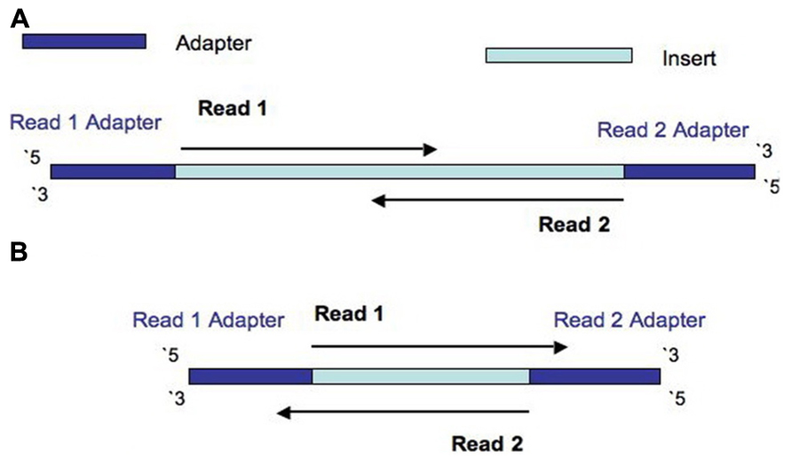
Trimming reads
Remove adapter read through.
Update to date list of Illumina adapters: https://support.illumina.com/downloads/illumina-customer-sequence-letter.html

Slide 27
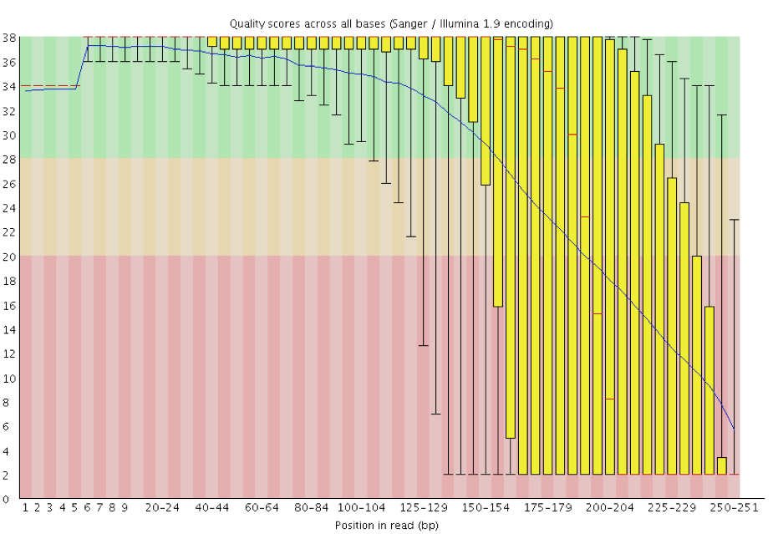
Trimming reads
Remove poor quality reads
My opinion: Don’t trim on quality. Let the assembler correction and consensus correction deal with it.

Slide 28
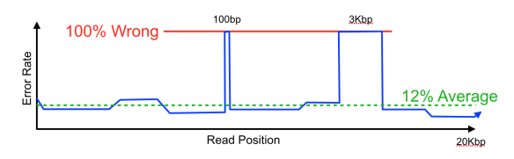
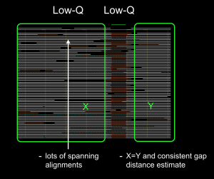
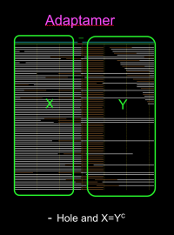
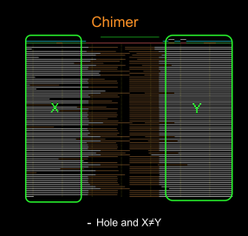
Trimming reads

Slide 29
Trimming reads
Many tools available
Trimmomatic
CutAdapt
AlienTrimmer
Sickle
Trim Galore
Scythe
Prinseq
…
Warning: Some assemblers expect untrimmed input.
Allpaths-LG
Mira
Spades
BBMerge can be used to discover adapters.

Slide 30
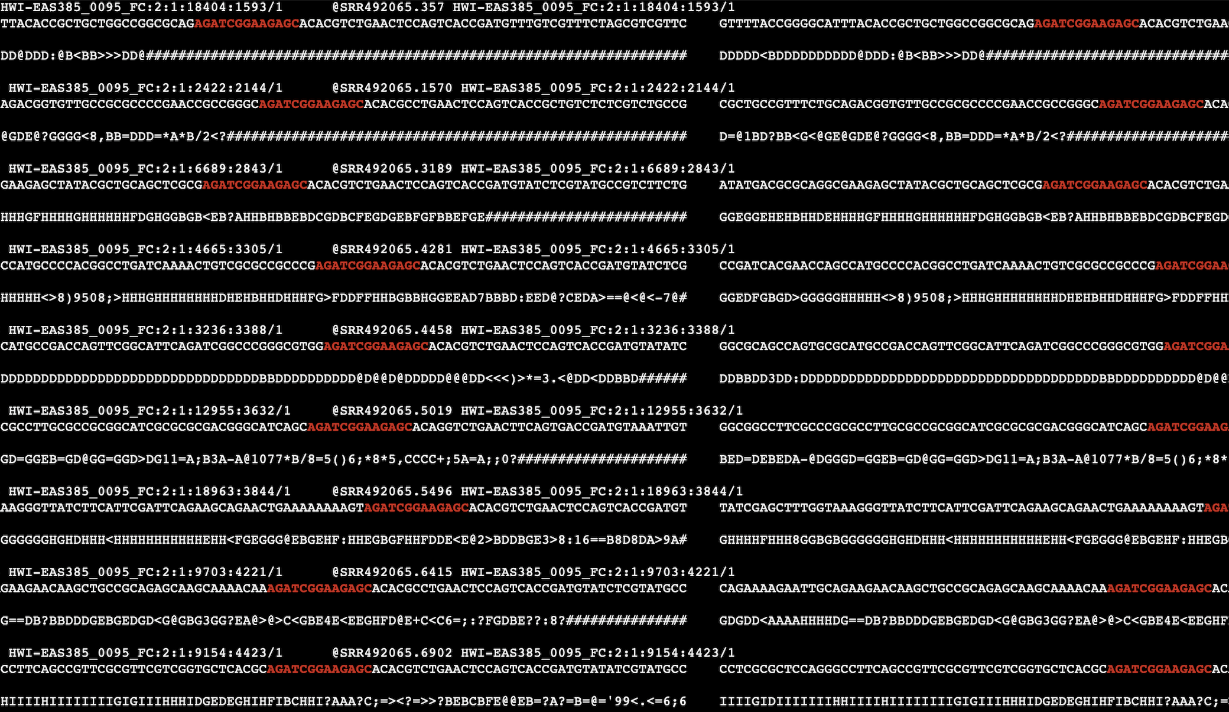
Trimming reads
Highlighted primer sequence shows the start of adapters in Illumina paired reads and the symmetric nature of the pattern (check you’re trimming correct adapter).

Slide 31
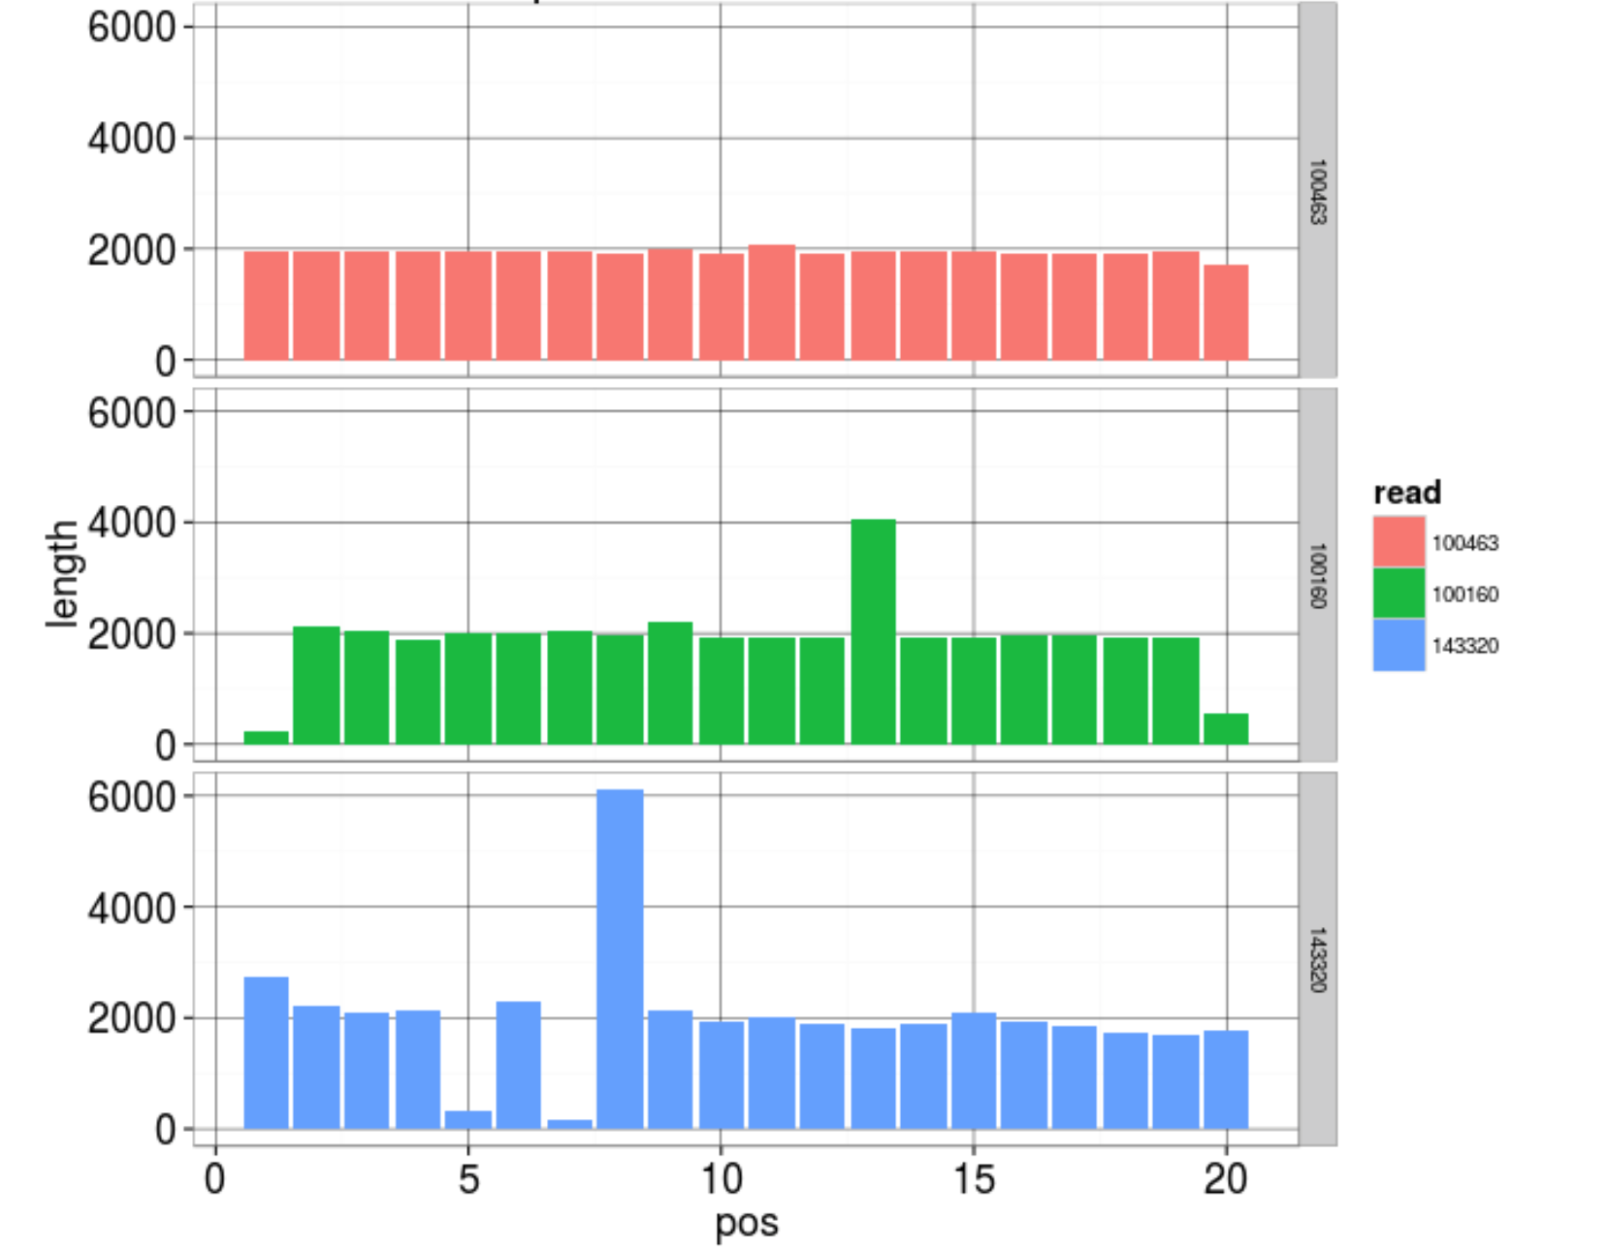
Trimming reads
SMRTbell adapter:
ATCTCTCTCTTTTCCTCCTCCTCCGTTGTTGTTGTTGAGAGAGAT

Slide 32
Duplication Removal
Why do duplicates arise?
Optical duplicates (amplified cluster mistaken for multiple clusters)
PCR duplicates
Why are duplicates bad?
Often indicates library preparation error
Poor overlap information
Increased complexity, computation time, and resources
How to remove duplicates:
Prinseq
FastUniq
ParDRe
…

Slide 33
Reference based filtering
Contaminants identified from Blast, Kraken, Kaiju, etc imply available references.
Reads can be aligned to these sequences.
Filter out reads that align uniquely to those sequences.
This can still over-filter.
Alternatively, filter contaminants after assembly.

Slide 34
Summary
FastQC
Lots of diagnostic plots
Trim adapter sequence.
Remove duplicates from heavily duplicated data.
Treat contamination analyses as suggestive.
Remove heavy contamination.

